Slide 1


Beginning Python
Where to write code
Providing Input to scripts
Basic Python code components
Dr. Tateosian

Slide 2
Where to write code?
Any text editor or the ArcGIS Python Window; However, IDE’s have more.
Integrated development environment (IDE)
Interactive.
Write/save/run scripts.
Color coding
Tab completion
Syntax checking
Debugging
Python IDEs:
PythonWin, PyScripter, PyCharm (for Windows OS)
Wingware (for Linux/Mac OS)
iPythonNotebook (online IDE)

Slide 3
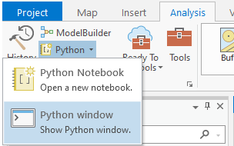
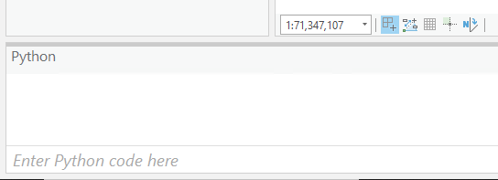
ArcGIS Pro Python window

Slide 4
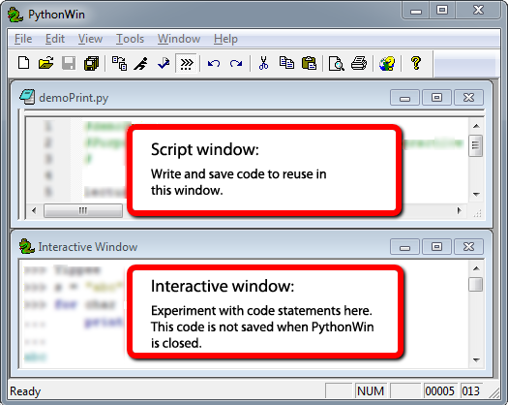
PythonWin

Slide 5
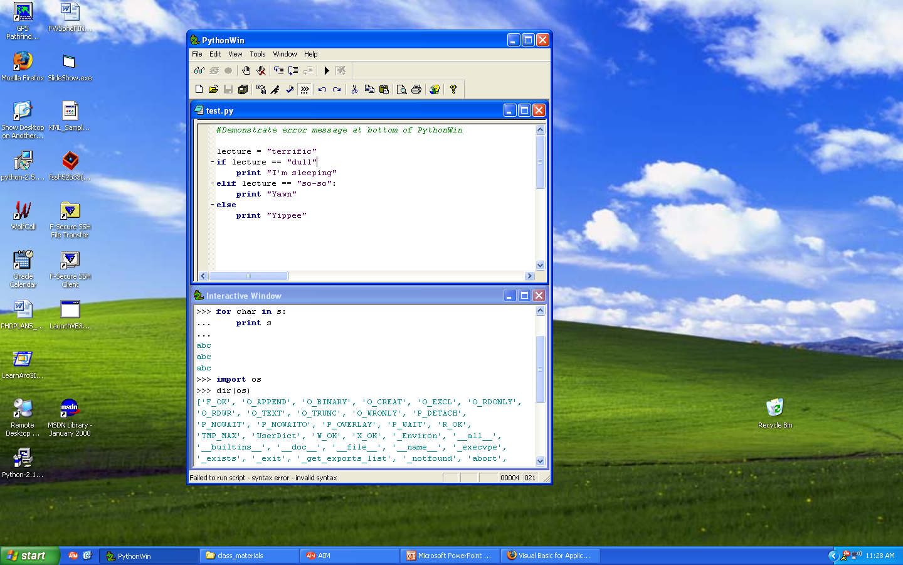
PythonWin Interface
Menus
Toolbars
debugging, standard
Script window
Write and save code
(permanent)
Interactive window
Test lines of code
Report messages
(temporary)
Feedback
Syntax error or success

Slide 6
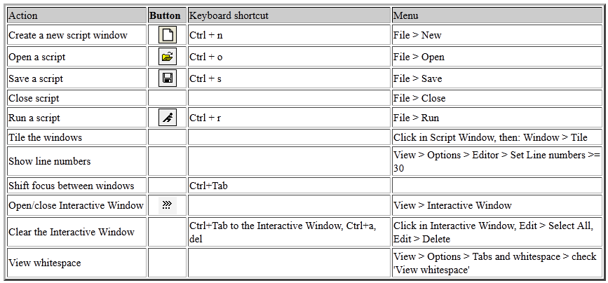
PythonWin standard toolbar
Standard toolbar

Slide 7
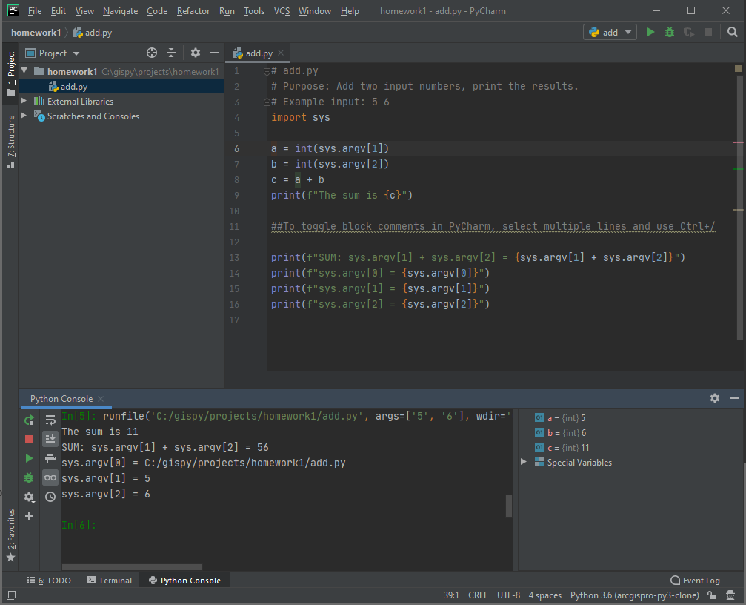
Script Window
Write and save code to reuse in this window.
Python Console
Execute individual lines of code.
The code is not saved when Pycharm is closed.
Check 'Run with Python Console.'
Notes:
Right click and select: Execute selection in Python Console or Execute line in console if no selection was made.

Slide 8
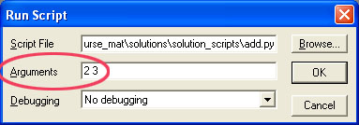
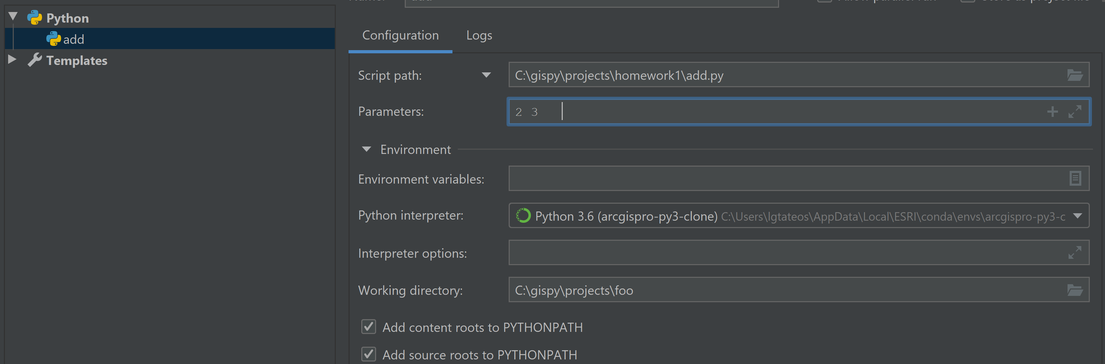
Passing arguments into a script
# add.py
# Purpose: Add two input numbers, print the results.
import sys
a = int(sys.argv[1])
b = int(sys.argv[2])
c = a + b
print(f"The sum is {c}")
add.py run/debug
configuration
Notes:
Do you have any questions about this script?

Slide 9
Line by line example questions
# add.py
# Purpose: Add two input numbers, print the results.
import sys
a = int(sys.argv[1])
b = int(sys.argv[2])
c = a + b
print(f"The sum is {c}")
What does # mean?
What does import do?
What variables are in this script?
What do the equals signs do (=)?
What does sys.argv mean?
What does int do?

Slide 10
Line by line example answers
# add.py
# Purpose: Add two input numbers, print the results.
import sys
a = int(sys.argv[1])
b = int(sys.argv[2])
c = a + b
print(f"The sum is {c}")
# symbol means what follows on that line is a comment just for human readers
import sys (lets you use things from the sys module)
variables (a and b are variables; they are assigned values with “=“ )
sys.argv (argument vector; the list of things you send in when you run it)
int (converts a string to an integer)
The print statement has an f so that you can print a variable.

Slide 11
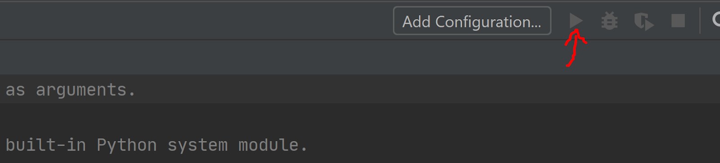
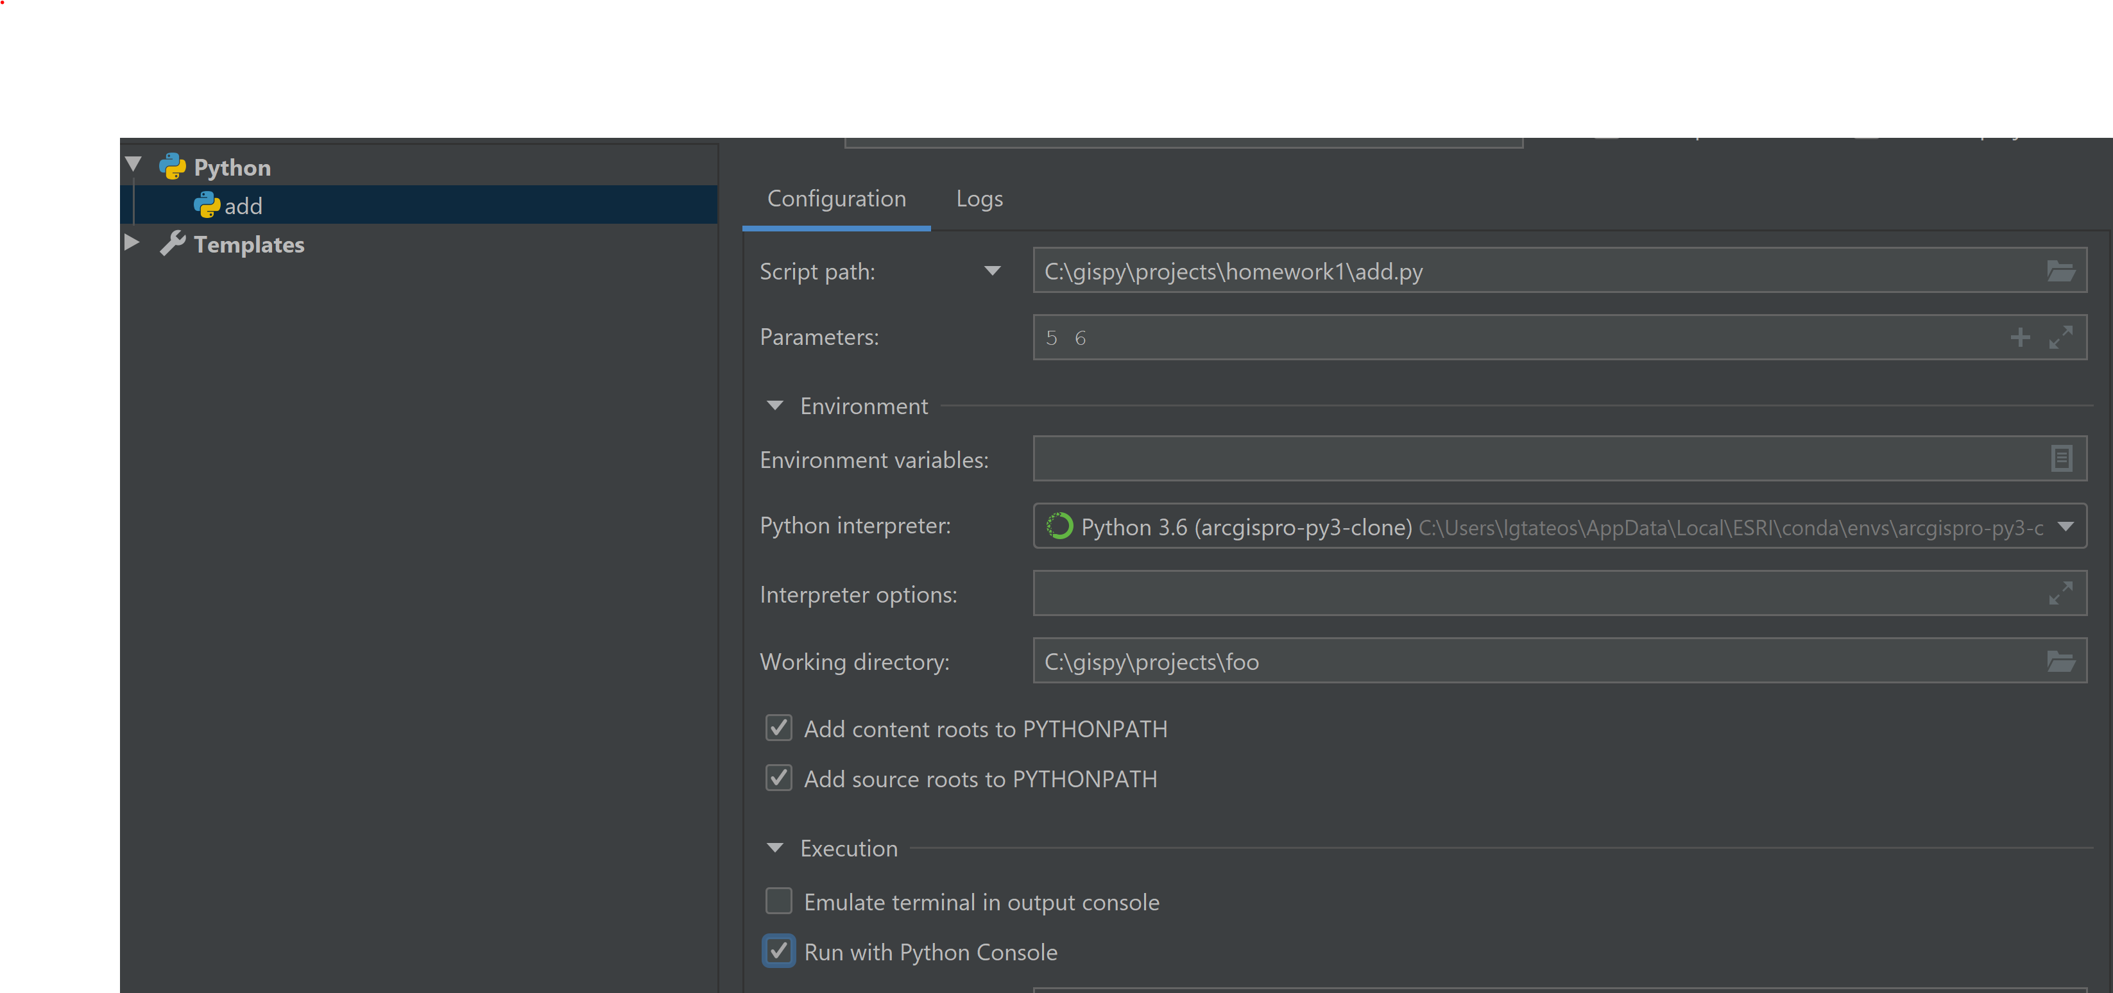
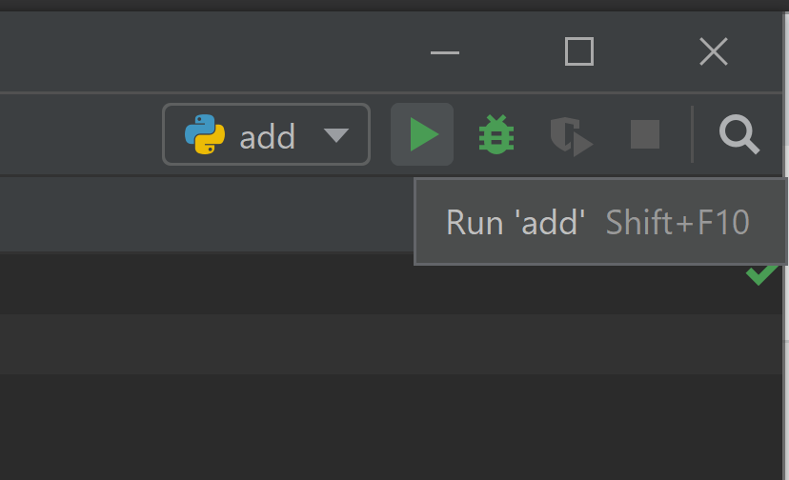
Hands on: Run add.py in PyCharm
Output:
Output:

Slide 12
Demo: Passing input into a script

Slide 13
Meaning of the plus sign (+)
Output 1:
The sum is 11
Output 2:
The sum is 11
SUM: sys.argv[1] + sys.argv[2] = 56 WHY?
sys.argv[0] = C:\<my directory path>\add.py
sys.argv[1] = 5
sys.argv[2] = 6

Slide 14
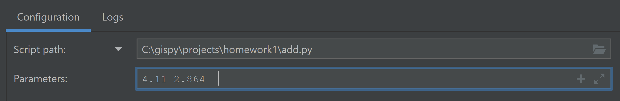
Passing in numbers
Output:
File "C:/gispy/projects/homework1/add.py", line 6, in <module>
a = int(sys.argv[1])
ValueError: invalid literal for int() with base 10: '4.11'
# add.py
# Purpose: Add two input numbers, print the results.
import sys
a = int(sys.argv[1])
b = int(sys.argv[2])
c = a + b
print(f"The sum is {c}")

Slide 15
Passing in floating point numbers
Output:
The sum is 6.974
SUM: sys.argv[1] + sys.argv[2] = 4.112.864
sys.argv[0] = C:/gispy/projects/homework1/add.py
sys.argv[1] = 4.11
sys.argv[2] = 2.864
# add.py
# Purpose: Add two input numbers, print the results.
import sys
a = float(sys.argv[1])
b = float(sys.argv[2])
c = a + b
print(f"The sum is {c}")

Slide 17

Cleaning up a messy workspace
Notes:
Hello everyone! Picture yourself in your dream job, working with a great organization. You just started and you want to impress your supervisor. She asks you to help out with organizing the GIS vector data. The shared workspace is a mess because they don't have consistent naming conventions and there may be duplicates, outdated data, and so forth. She says the first thing she needs is an inventory of what in the workspace. She wants it by next week.

Slide 18
Start with an inventory
# describe_fc.py # Purpose: Print information about each feature class in a workspace. # Usage: Workspace # Example input: C:/gispy/data/ch02 # Output: A list of basic information about each feature class. # Author: Lou Lou Who 7/20/2055 import arcpy import sys # GET the input workspace from the user. arcpy.env.workspace = sys.argv[1] # GET a list of the feature classes in the workspace. fcs = arcpy.ListFeatureClasses() # PRINT basic information about each feature class in the folder. print(f'Feature classes in folder {arcpy.env.workspace}') for fc in fcs: desc = arcpy.Describe(fc) print(f'Name: {fc}') print(f'Data type: {desc.dataType}') print(f'Data class: {desc.dataSetType}') print(f'Type: {desc.featureType}') print(f'Shape type: {desc.shapeType}') print(f'Has M: {desc.hasM}') print(f'Has Z: {desc.hasZ}') print() print('Feature class list complete.')
Notes:
You'll probably need to write some Python code answer this question. In fact, you might start with some code that looks a bit like this.
Right now, if you don't have any prior programming experience, you may not even be able to decipher this code. This code lists all the feature classes in a workspace and prints meta information about each one.
But what does import mean? What do the different colors mean? Why is some of it indented? What does it all mean? In this series of videos on basic Python components we'll start to fill in some of these blanks.
;;

Slide 19
Python components
Variables
Comments
Keywords
Modules
Indentation
Objects
Functions
Built-ins
Assignment statements
Data structures
# describe_fc.py # Purpose: Print information about each feature class in a workspace. # Usage: Workspace # Example input: C:/gispy/data/ch02 # Output: A list of basic information about each feature class. # Author: Lou Lou Who 7/20/2055 import arcpy import sys # GET the input workspace from the user. arcpy.env.workspace = sys.argv[1] # GET a list of the feature classes in the workspace. fcs = arcpy.ListFeatureClasses() # PRINT basic information about each feature class in the folder. print(f'Feature classes in folder {arcpy.env.workspace}') for fc in fcs: desc = arcpy.Describe(fc) print(f'Name: {fc}') print(f'Data type: {desc.dataType}') print(f'Data class: {desc.dataSetType}') print(f'Type: {desc.featureType}') print(f'Shape type: {desc.shapeType}') print(f'Has M: {desc.hasM}') print(f'Has Z: {desc.hasZ}') print() print('Feature class list complete.')
Syntax highlighting:
text color/font based on code features

Slide 20
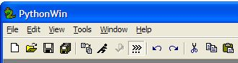
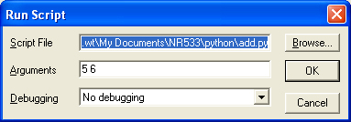
Hands on: Run add.py in PythonWin
Open the script, add.py
Run the script or Ctrl+R
Pass arguments (with space between arguments)
Uncomment the bottom
Select and click (Alt + 4)
Run again.
Output:
The sum is 11
Output:
The sum is 11
sys.argv[1] + sys.argv[2] = 56 WHY?
sys.argv[0] = C:\<my directory path>\add.py
sys.argv[1] = 5
sys.argv[2] = 6

Slide 21
Commenting code
# conditional_addfield.py
# Purpose: Add a field, if it does not already exist.
# Usage: field_name
# Example input: “bridges”
# Output: A shapefile with the new field added, if it didn’t already exist.
# Author: Donald Duck 8/22/2065
# Modified: Silvester 3/06/2080 to run in Python599
# GET input field name
# SET field name to input field name
# IF field exists THEN
#Reset values to zero
# ELSE
# CALL add field
# ENDIF
Header
(documentation
comments)
Body
(explanatory
comments)

Slide 22
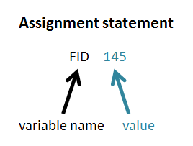
Basic building blocks
Variable is a name that represents a value:
Is bound to a value.
Value is not stored in variable; Variable just refers to (points to) a value stored somewhere in memory.
Expression is a value (number or string)
Examples: 2+2 ‘My string’
Statement is an instruction (does something or changes something)
Examples: print “Hello world”
FID = 145
Assignment statement sets the value of a variable.

Slide 23
Variable naming rules
A variable name must start with a letter or the underscore character.
A variable name cannot start with a number.
A variable name can only contain alpha-numeric characters and underscores (A-z, 0-9, and _ )
Avoid other special characters in names ( / \ & % # ! , . ; : and so forth)
Variable names are case-sensitive (age, Age and AGE are three different variables)
Cannot be keywords
# Legal variable names:
myvar = "North Carolina"
my_var = "North Carolina"
_my_var = "North Carolina"
myVar = "North Carolina"
MYVAR = "North Carolina"
myvar2 = "North Carolina"
# Illegal variable names:
2myvar = "North Carolina"
my-var = "North Carolina"
my var = "North Carolina"
def = "North Carolina"
hypothenuse = math.sqrt(adjacent**2 + opposite**2)
r = math.sqrt(dx**2 + dy**2)
Notes:
DEMO1: VARIABLES TYPING & USER INPUT ************************************
>>> var = "string"
>>> type(var)
<type 'str'>
>>> var = 1
>>> type(var)
<type 'int'>
>>> var = 1.0
>>> type(var) <type 'float'>

Slide 24

Variable naming conventions
Lower camel case (first word lower case, capitalize each successive word):
tableFieldName = "Street"
Snake case:
table_field_name = "Street"
Acronyms:
Lowercase if at the beginning of the variable name
gdbPath = "C:\\testerData.mdb"
Uppercase otherwise
inputFC = "streets.shp"
Notes:
DEMO1: VARIABLES TYPING & USER INPUT ************************************
>>> var = "string"
>>> type(var)
<type 'str'>
>>> var = 1
>>> type(var)
<type 'int'>
>>> var = 1.0
>>> type(var) <type 'float'>

Slide 25
Variable naming advise
Use descriptive variable names…
sa = s * s
square_area = side * side
…only when practical
hypothenuse = math.sqrt(adjacent**2 + opposite**2)
r = math.sqrt(dx**2 + dy**2)
Notes:
DEMO1: VARIABLES TYPING & USER INPUT ************************************
>>> var = "string"
>>> type(var)
<type 'str'>
>>> var = 1
>>> type(var)
<type 'int'>
>>> var = 1.0
>>> type(var) <type 'float'>

Slide 26
Python Objects
Everything in Python is an Object
Each object has:
A value data item represented by an object
An identity unique identifier, similar to a memory address
A type specifies what kind of values an object can hold and which operations are allowed
>>> river = "Arno“
>>> river
'Arno‘
>>> id(river)
15446688
>>> type(river)
<type 'str'>
>>> river = 96 >>> type(river) <type ‘int’>
Dynamically typed variables
Notes:
-----------------------------------------------------------
DEMO5: EVERYTHING IS AN OBJECT
******************************
>>> strg ="A String of Words"
>>> id(strg)
1075848016
>>> type(strg)
<type ’str’>
>>> strg
’A String of Words’
-----------------------------------------------------------
>>> # identity
>>> x = y = [1,2,3]
>>> x is y
True
>>> y is x
True
>>> z = [1,2,3]
>>> z is x
False
>>> z == x
True

Slide 28
Built-ins Part 1

Slide 29
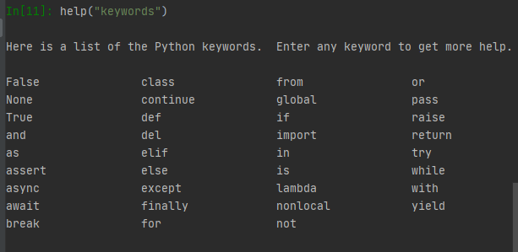


Python Keywords
have special meaning in Python
may not be used as variable names:
1. Case-sensitive Do this: if Don’t do this: IF or If.
2. All lower case, except True, False, and None.
3. Can't be used as variable name.
>>> def = "poised" Traceback ( File "<interactive input>", line 1 def = "poised" ^ SyntaxError: invalid syntax

Slide 30
Built-ins exceptions
Exceptions: common errors that Python can identify automatically.
An exception is thrown when one of these errors is detected.
A traceback message is generated and printed in the Interactive Window
The ‘bad’ script will stop running when an exception is printed.
Examples: SnytaxError, TypeError, NameError
>>> "a" + 1
Traceback (most recent call last):
File "C:\Users\lgtateos\AppData\Local\ESRI\conda\envs\arcgispro-py3-clone\lib\site-packages\IPython\core\interactiveshell.py", line 3437, in run_code
exec(code_obj, self.user_global_ns, self.user_ns)
File "<ipython-input-17-42f7d05b4f13>", line 1, in <module>
"a" + 1
TypeError: can only concatenate str (not "int") to str
giraffe
Traceback (most recent call last):
File "C:\Users\lgtateos\AppData\Local\ESRI\conda\envs\arcgispro-py3-clone\lib\site-packages\IPython\core\interactiveshell.py", line 3437, in run_code
exec(code_obj, self.user_global_ns, self.user_ns)
File "<ipython-input-18-04fb1e3b0695>", line 1, in <module>
giraffe
NameError: name 'giraffe' is not defined

Slide 31
Built-in constants
Values assigned as soon as Python is launched
Booleans we will use: True, False, None
>>> type(True)
<type 'bool'>
>>> True
True
Geoprocessing example
import arcpy
arcpy.env.overwriteOutput = True

Slide 32
Built-in modules (a.k.a) Standard modules
A Python module is a set of related code. It’s also a Python script.
Python has a set of standard modules automatically installed.
Examples: math, os, sys, shutils, winsound, time
Import a module to use the functions & variables (properties) it contains.
Import statements use keyword import followed by the module name.
import sys
After import, use dot notation to use module functions and properties.
moduleName.property
moduleName.functionName(argument1,
argument2, …)

Slide 33
Standard module examples
moduleName.property
moduleName.functionName(argument1,
argument2, …)
‘listdir’ is an ‘os’ module function
‘radians’ is a ‘math’ module function
‘argv’ is a ‘sys’ module property
import os
os.listdir('C:/temp')
>>> ['output.csv', 'park.dbf',
'park.shp', 'park.shx']
import math
math.radians(180)
>>> 3.141592653589793
import sys
sys.argv[0] >>> 'C:/gispy/projects/foo/add.py'

Slide 35
Built-ins Part 2

Slide 36
Functions

Slide 37
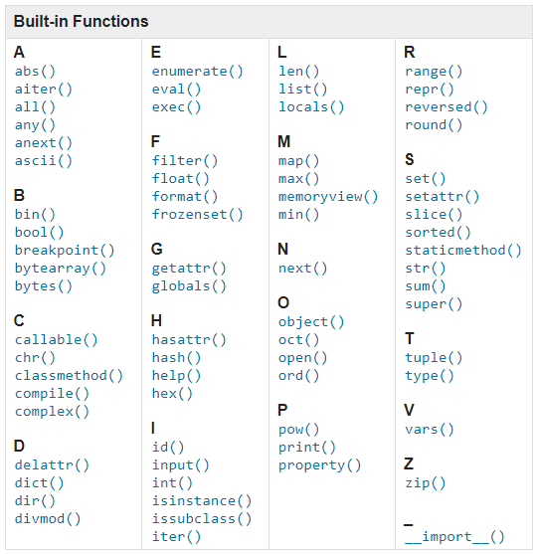
Python built-in Functions
The Python interpreter has a number of functions and types built into it that are always available.
Don’t do this:
zip = "myfile.zip"
Don’t use built-ins
as variable names!

Slide 38
Function terminology
>>> round(1.7) >>> min(1, 2, 3) 2.0 1
function – a named set of code that performs a task round, min, arcpy.Exists(path), int, print
built-in function – a function supplied by Python round, min, int, print
function call – a code statement that invokes a function
We called the round function, then we called the min function.
passing arguments – providing input for a function
1.7 is passed into the round function
return value – information returned from a function

Slide 39
Return value
Information returned from a function
>>> round(1.7)
2
>>> min(1, 2, 3)
1 >>> help(round) Help on built-in function round in module builtins:
round(number, ndigits=None)
Round a number to a given precision in decimal digits.
The return value is an integer if ndigits is omitted or None. Otherwise
the return value has the same type as the number. ndigits may be negative.
round returned a 2
min returned a 1 help function does not return anything. It just prints something.

Slide 40
The help function
shows how the function can be used
prints a template (a signature)
the arrow points to what it gives you as a return value
>>> help(round) Help on built-in function round in module __builtin__:
round(...) round(number[, ndigits]) -> floating point number
>>> help(min) Help on built-in function min in module __builtin__: min(...) min(iterable[, key=func]) -> value min(a, b, c, ...[, key=func]) -> value With a single iterable argument, return its smallest item. With two or more arguments, return the smallest argument.

Slide 41
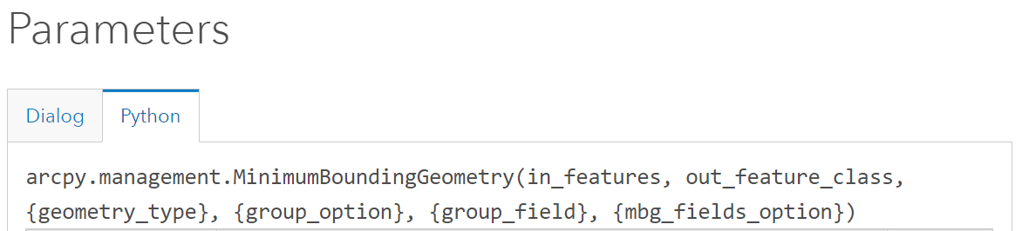
Signature
A template (or blueprint) = name followed by list of parameters (required and optional).
The signature of round printed by the built-in help function
round(number, ndigits=None)
arcpy help shows a signature

Slide 42
Parameter vs. argument
Sometimes used interchangeably.
parameter – piece of info. passed into a function
round(number, ndigits=None)
argument – specific. values the expression being passed into the function
>>> round(1.7) >>> min(1, 2, 3)
parameters
argument
arguments

Slide 44
Indentation

Slide 45
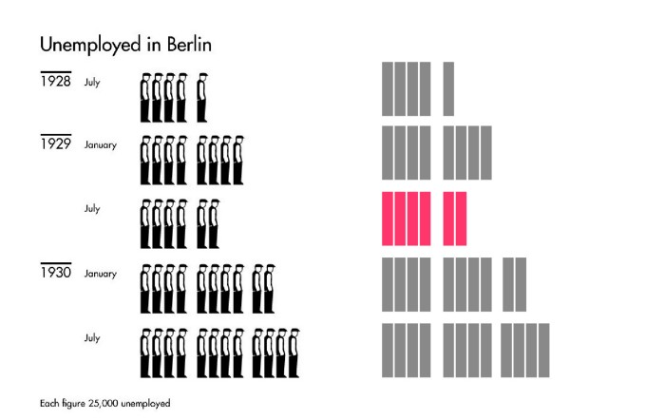
Otto Neurath’s Isotypes: https://in.pinterest.com/pin/558446422516061130/
Notes:
Gestalt principles are rules that describe how the human eye perceives visual elements. The main idea is that when we view complex scenes we tend to reduce them to more simple shapes. These graphs of depression era unemployment rates illustrate two of these principles.

Slide 46
How to read the graphs
Otto Neurath’s Isotypes: https://in.pinterest.com/pin/558446422516061130/
Notes:
In the left graph, each figure represents 25000 unemployed people. The right graph is a simplified version of the left graph, in which the worker icons are replaced by rectangles.

Slide 47
Proximity
Otto Neurath’s Isotypes: https://in.pinterest.com/pin/558446422516061130/
Notes:
We automatically simplify both of these graphs in two ways.
We see 5 separate rows because the icons are closer together horizontally than vertically.
We also see groups of 4 that are closer to each other than the other icons in that row.
Gestalt calls this the proximity principle.

Slide 48
Similarity
Otto Neurath’s Isotypes: https://in.pinterest.com/pin/558446422516061130/
Notes:
We also see these as two separate graphs, because the of the similarity principle.
the figures with the hats belong to one group and the rectangles belong to another.
Finally, the gray and pink rectangles in the right graph creates a grouping that is not there in the left graph, separating the pink month from all the rest.

Slide 49
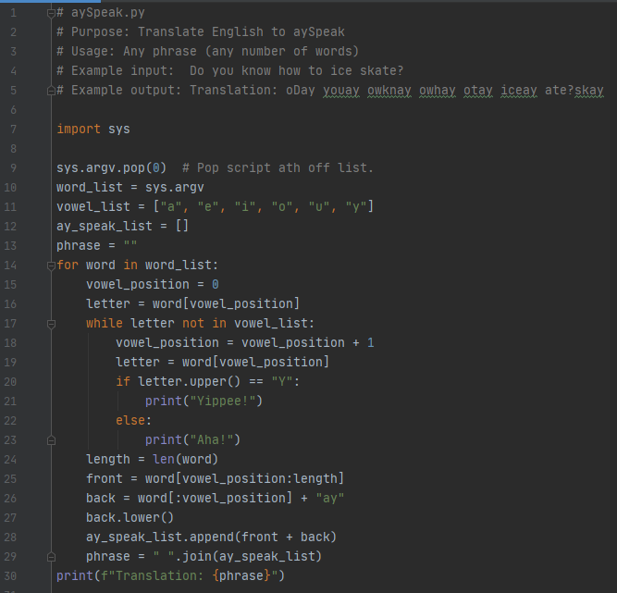
Python and Gestalt
Notes:
So, what does Gestalt have to do with Python code?
Python code uses proximity and similarity to make code easier to read.
The indentation creates proximate groups.
The syntax coloring forms similarity patterns.
======================================
# aySpeak.py # Purpose: Translate English to aySpeak # Usage: Any phrase (any number of words) # Example input: Do you know how to ice skate? # Example output: Translation: oDay youay owknay owhay otay iceay ate?skay import sys sys.argv.pop(0) # Pop script ath off list. word_list = sys.argv vowel_list = ["a", "e", "i", "o", "u", "y"] ay_speak_list = [] phrase = "" for word in word_list: vowel_position = 0 letter = word[vowel_position] while letter not in vowel_list: vowel_position = vowel_position + 1 letter = word[vowel_position] if letter.upper() == "Y": print("Yippee!") else: print("Aha!") length = len(word) front = word[vowel_position:length] back = word[:vowel_position] + "ay" back.lower() ay_speak_list.append(front + back) phrase = " ".join(ay_speak_list) print(f"Translation: {phrase}")

Slide 50
Python controls grouping with indentation
Notes:
This script uses indentation to group lines 15 through 29.
Another example:
GET tree inventory dataset
GET list of spread sheets
FOR each spread sheet in the list
FOR EACH tree record in the current spread sheet
IF tree record is not in the database THEN
ADD tree record to the database
END IF
END FOR
END FOR

Slide 51
"Block of code"
Related code inside
of a control structure
Indented to the same level
FOR-loop control structure
Notes:
We refer to this as a BLOCK OF CODE
A block of code are contiguous related lines of code that are indented inside a control structure.
A control structure is a mechanism that controls the flow of code. As an example, this is a FOR-loop control structure. The code inside this block gets repeated for as many words as there are in the word list.
Blocks of code can have blocks of code inside them, indented even further. This FOR-loop has a WHILE loop control structure inside of it.

Slide 52
Block of code indented to the same level
WHILE-loop control structure
Notes:
The code inside the WHILE-loop structure is indented another level.
In fact, there is even a third level– inside the IF and ELSE blocks. Lines 21 and 23 are indented the same level because IF and ELSE are all part of one unified control structure.

Slide 53
Indentation guides
vertical lines
Notes:
Some IDEs even draw indentation guides. There are vertical lines connecting code indented to the same level to make it easier to see indentation levels. (BTW, connectivity is another Gestalt principle through which we see patterns.)

Slide 54
Indentation is meaningful
for i in range(10):
print(i)
DO THIS
DON'T DO THIS
for i in range(10):
print(i)
Notes:
Just to be clear, indentation is not used just for the human to be able to read the code. The Python interpreter needs it too. In some languages, curly braces are used to group blocks of code. Python uses indentation instead. A FOR-loop control structure must be followed by at least one line of indented code, or else a SyntaxError will be thrown.

Slide 55
Indentation groups code
for i in range(3):
print('DO')
print('BEEP')
print('BA')
print('BOOM')
DO
BEEP
DO
BEEP
DO
BEEP
BA
BOOM
DO
BEEP
BA
BOOM
DO
BEEP
BA
BOOM
DO
BEEP
BA
BOOM
for i in range(3):
print('DO')
print('BEEP')
print('BA')
print('BOOM')
Notes:
Indentation groups code for the Python interpreter, not just for humans. These two sets of code are identical except for indentation. But the output is very different. One results in 8 lines of output. The other gives 12.

Slide 56
Dedent code outside the block
for i in range(3):
print('DO')
print('BEEP')
print('BA')
print('BOOM')
print('HAZAA')
dedent == move back to the left (unindent)
Notes:
Dedented code indicates to the interpreter that the code is outside of the code structure. Hazaa is outside of the loop. Sing it to yourself

Slide 57
What you should know
Gestalt theory
Block of code
Control structure
Indentation guide
Mandatory indentation
Dedent

Slide 59
What you should know
Why use Python
Integrated development environments (IDEs)
Passing arguments into scripts
Basic Python code components:
naming & initializing variables
comments
keywords
Built-ins:
modules
functions
constants
exceptions
indentation
objects
function vocabulary
assignment statements
data structures

Slide 61
Appendix slides

Slide 62
In class: tryMe
learn how to execute single lines of Python code interactively
call functions
throw exceptions
type each code statement one at a time in the interactive window
before running each statement, predict the results
select the return (or enter) to run each line of code
how accurate were your predictions?

Slide 63
‘tryMe’ take home lessons
Variable names are case-sensitive.
Python dynamically changes the data type when you assign values to a variable.
Don’t use keywords or built-ins as variable names!
>>> type(min) <type 'builtin_function_or_method'> >>> min(1, 2, 3) 1 >>> min = 5 >>> min(1, 2, 3) Traceback (most recent call last): File "<interactive input>", line 1, in <module> TypeError: 'int' object is not callable >>> type(min) <type 'int'>

Slide 64
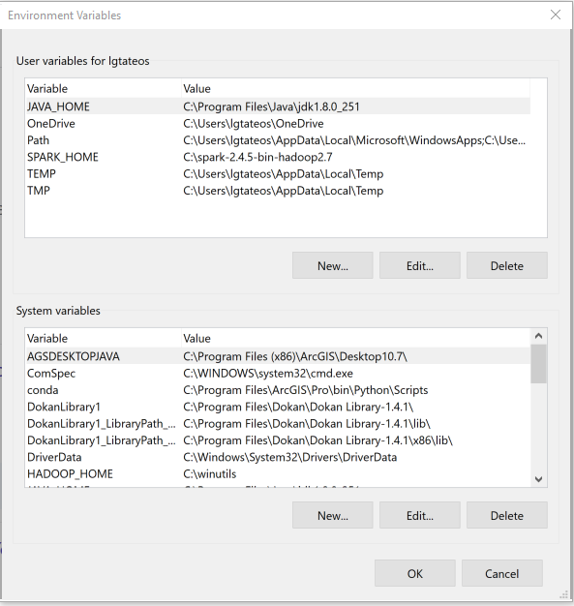

Slide 65
What do you see?
# describe_fc.py # Purpose: Print information about each feature class in a workspace. # Usage: Workspace # Example input: C:/gispy/data/ch02 # Output: A list of basic information about each feature class. # Author: Lou Lou Who 7/20/2055 import arcpy import sys # GET the input workspace from the user. arcpy.env.workspace = sys.argv[1] # GET a list of the feature classes in the workspace. fcs = arcpy.ListFeatureClasses() # PRINT basic information about each feature class in the folder. print(f'Feature classes in folder {arcpy.env.workspace}') for fc in fcs: desc = arcpy.Describe(fc) print(f'Name: {fc}') print(f'Data type: {desc.dataType}') print(f'Data class: {desc.dataSetType}') print(f'Type: {desc.featureType}') print(f'Shape type: {desc.shapeType}') print(f'Has M: {desc.hasM}') print(f'Has Z: {desc.hasZ}') print() print('Feature class list complete.')

